Slide 1


Predicting the price of
ETH using
Akvilė Kovalčikaitė, Lavan Paramesvaran, Shiyu Hua

Slide 2
Scraping Data and Dataset Preparation
Had to scrape the data in three separate batches.
Used RedditExtractoR.
Second batch required a completely different approach - GitHub code.
Uneven dataset sizes.
Difficulties matching the three separate datasets:
Missing columns, data imputation for scores.
9 columns and 23,697 observations.

Slide 3

DATA COLUMNS | DESCRIPTION
index | unique identifier
date | date of the comment created
comment | text of the comment
threadTitle | title of the thread
threadText | text of the thread
commentScore | number of upvotes minus the number of downvotes of the comment
threadScore | number of upvotes minus the number of downvotes of the thread
hits | the frequency of Google searches for “Ethereum” on a daily basis
price | daily Ethereum adjusted close price

Slide 4
Data Cleaning
Encoded foreign characters using UTF-8.
Still posed issues, had to manually adjust some columns using the stringi library.
Removed hyperlinks, numbers, punctuation, capitalization, codes for apostrophes (e.g. ‘\030’).
Removed stopwords.

Slide 5
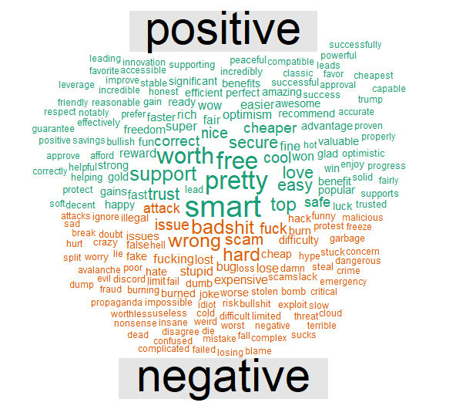
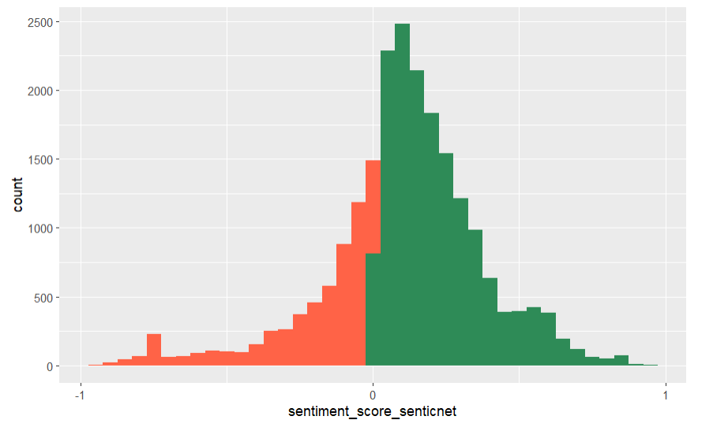
Sentiment analysis
Notes:
After data cleaning, we first look at the sentiment analysis to evaluate the sentiment of each comment. Using unnest token, anti join stop words, we created a word cloud separate positive and negative words. We can see from the word cloud, most frequently appeared positive words are smart, free, worth, support, while most common negative words are wrong, bad, issue, scam. After identifying the positive and negative words, we continue to evaluate the sentiment score for each of the comments in our dataset. Here on the right is a distribution of sentiment score of all comments using the senticnet lexicon. It showed a slightly right skewness with more neutral and positive scores. We also use afinn and loughran_mcdonald to come up with the sentiment scores. The sentiment scores later will be used in our modeling process. I will pass on to Lavan to discuss our model.

Slide 6
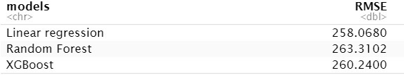
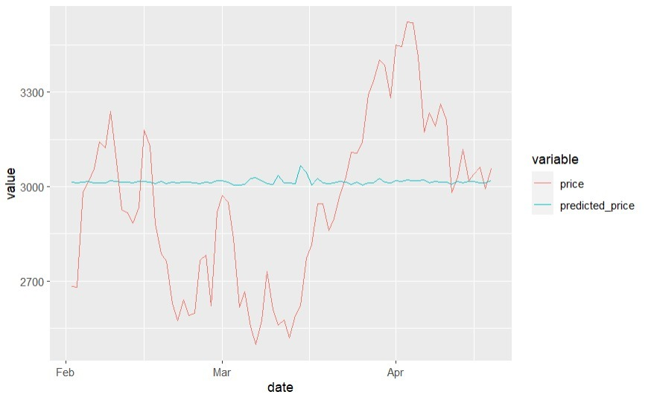
Modeling & results
Simple Linear Regression was marginally the best performing model
We choose to use XGBoost as our primary model since we could tune it and scale its performance with additional data
The performance of our model was poor since it didn’t seem to account for price fluctuations

Slide 7
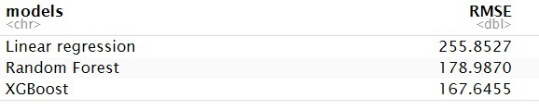
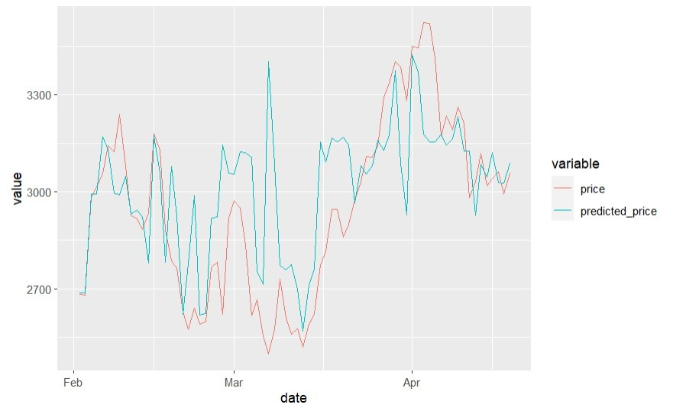
Improved Modeling & conclusion
We added data for comment scores on reddit posts, data on Google hits, and 3 additional sentiment score variables
Additional 3 sentiment score variables were obtained by scoring the original sentiment data using the lexicon packages affin, senti and mcd
New XGBoost model was relatively effective at predicting price
Some exaggerations in the amplitude exist making the model inaccurate to be fully relied upon

Slide 8
Limitations
Future improvements
We didn’t end up using thread data for our analysis
Our approach doesn’t account for major price spikes or price corrections as it doesn’t consider the underlying value of Ethereum as an asset
Opportunities that present the greatest arbitrage are not accounted for
The accuracy of our model is still too low to be fully relied upon as a trading tool
We find a way to reliably retrieve thread data and score it in relation to comments within threads
We collect sentiment data on specific Ethereum blogs and analysts to account for changes in the underlying value of Ethereum as an asset
We collect data over a 6-12 month period to account for large fluctuations in price
We combine the model with other models such as a time series analysis or risk assessment model to generate more accurate predictions

Slide 9
Thank you!

